Slide 1
CS3006 Parallel and Distributed Computing
Fall 2021
National University of Computer and Emerging Sciences

Slide 2
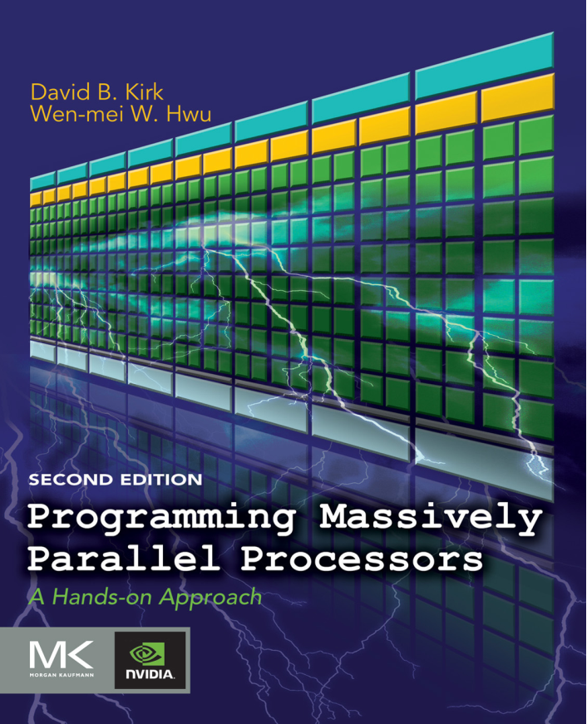
Reference Book (Chapter#5)
Programming Massively Parallel Processors
David B. Kirk
Wen-mei W. Hwu

Slide 3
Data-Parallel Execution Model

Slide 4
So Far..
A CUDA kernel function that is executed by a massive number of threads.
The data to be processed by these threads is first transferred from the host memory to the device global memory
The threads then access their portion of the data from the global memory using their block IDs and thread IDs.
These simple CUDA kernels will likely achieve only a small fraction of the potential speed of the underlying hardware.
The poor performance is due to the fact that global memory, which is typically implemented with dynamic random access memory (DRAM), tends to have long access latencies (hundreds of clock cycles) and finite access bandwidth

Slide 5
To circumvent such congestion, CUDA provides a number of additional methods for accessing memory that can remove the majority of data requests to the global memory

Slide 6

5.1 IMPORTANCE OF MEMORY ACCESS EFFICIENCY
Consider the matrix multiplication, for example,
The most important part of the kernel in terms of execution time is the for loop that performs inner product calculation
In every iteration of this loop, two global memory accesses are performed for one floating-point multiplication and one floating-point addition.
One global memory access fetches a d_M[] element and the other fetches a d_N[] element
One floating-point operation multiplies the d_M[] and d_N[] elements fetched and the other accumulates the product into Pvalue.
Thus, the ratio of floating-point calculation to global memory access operation is 1:1 or 1.0; compute to global memory access (CGMA) ratio

Slide 7
CGMA has major implications on the performance of a CUDA kernel.
In a high-end device today, the global memory bandwidth is around 200 GB/s
With 4 bytes in each single-precision floating-point value, one can expect to load no more than 50 (200/4) giga single-precision operands per second
With a CGMA ration of 1.0, the matrix multiplication kernel will execute no more than 50 giga floating-point operations per second (GFLOPS).
50 GFLOPS is only a tiny fraction of the peak single-precision performance of 1,500 GFLOPS or higher for these high-end devices

Slide 8
5.2 CUDA DEVICE MEMORY TYPES
CUDA supports several types of memory that can be used by programmers to achieve a high CGMA ratio and thus a high execution speed in their kernels
Global Memory
Constant Memory: The constant memory supports short-latency, high-bandwidth, read-only access by the device when all threads simultaneously access the same location
Registers and Shared memory are on-chip memories.
Variables that reside in these types of memory can be accessed at very high speed in a highly parallel manner

Slide 9
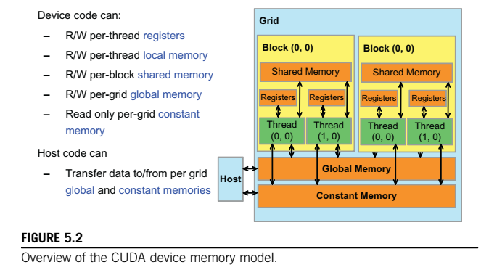

Slide 10
Registers are allocated to individual threads; each thread can only access its own registers
A kernel function typically uses registers to hold frequently accessed variables that are private to each thread
Shared memory is allocated to thread blocks;
all threads in a block can access variables in the shared memory locations allocated to the block
shared memory is an efficient means for threads to cooperate by sharing their input data and the intermediate results of their work

Slide 11
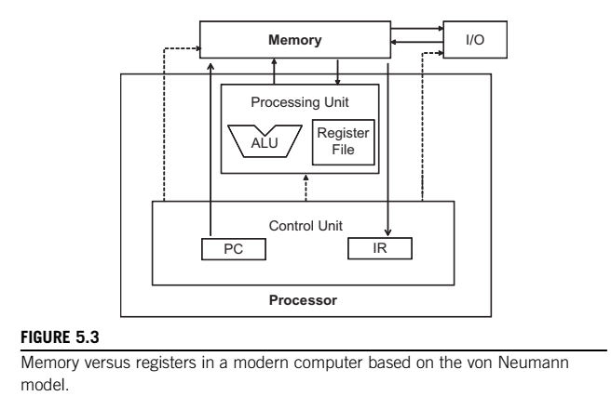

Slide 12
the processor uses the PC value to fetch instructions from memory into the IR
The bits of the fetched instructions are then used to control the activities of the components of the computer
Using the instruction bits to control the activities of the computer is referred to as instruction execution
Arithmetic instructions in most modern processors have “built-in” register operands. For example, a typical floating addition instruction is of the form fadd r1, r2, r3
Notes:
where r2 and r3 are the register numbers that specify the location in the register file where the input operand values can be found, Therefore, when an operand of an arithmetic instruction is in a register, there is no additional instruction required to make the operand value available to the arithmetic and logic unit (ALU) where the arithmetic calculation is done.

Slide 13
On the other hand, if an operand value is in global memory, one needs to perform a memory load operation to make the operand value available to the ALU
load r2, r4, offset
fadd r1, r2, r3
In modern computers, the energy consumed for accessing a value from the register file is at least an order of magnitude lower than for accessing a value from the global memory

Slide 14
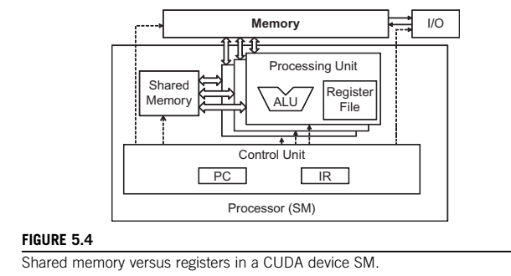

Slide 15
Both the Shared Memory and Registers in a CUDA device are on chip, they differ significantly in functionality and cost of access:
When the processor accesses data that resides in the shared memory, it needs to perform a memory load operation, just like accessing data in the global memory.
However, because shared memory resides on-chip, it can be accessed with much lower latency and much higher bandwidth than the global memory.
Because of the need to perform a load operation, share memory has longer latency and lower bandwidth than registers.
Shared memory is designed to support efficient, high-bandwidth sharing of data among threads in a block

Slide 16
A CUDA device SM typically employs multiple processing units to allow multiple threads to make simultaneous progress
Threads in a block can be spread across these processing units.
Therefore, the hardware implementations of shared memory in these CUDA devices are typically designed to allow multiple processing units to simultaneously access its contents to support efficient data sharing among threads in a block.

Slide 17
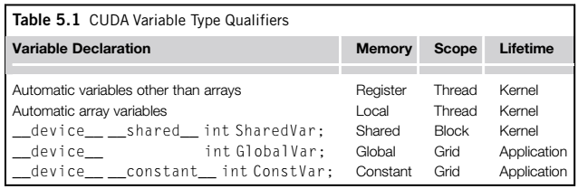

Slide 18
All automatic scalar variables declared in kernel and device functions are placed into registers
When a kernel function declares an automatic variable, a private copy of that variable is generated for every thread
Automatic array variables are not stored in registers. Instead, they are stored into the global memory and may incur long access delays and potential access congestions
If a variable declaration is preceded by the keyword __shared__, it declares a shared variable in CUDA
Shared variables reside in shared memory
CUDA programmers often use shared variables to hold the portion of global memory data that are heavily used in an execution phase of a kernel

Slide 19
If a variable declaration is preceded by the keyword __constant__ it declares a constant variable in CUDA
Declaration of constant variables must be outside any function body.
The scope of a constant variable is all grids, meaning that all threads in all grids see the same version of a constant variable.
A variable of which the declaration is preceded only by the keyword __device__ is a global variable and will be placed in the global memory.
Accesses to a global variable are slow.
Latency and throughput of accessing global variables have been improved with caches in more recent devices.
Thus, global variables can be used as a means for threads to collaborate across block

Slide 20
5.3 A STRATEGY FOR REDUCING GLOBAL MEMORY TRAFFIC
Global memory is large but slow, whereas the shared memory is small but fast
A common strategy is partition the data into subsets called tiles so that each tile fits into the shared memory
The term tile draws on the analogy that a large wall (i.e., the global memory data) can be covered by tiles (i.e., subsets that each can fit into the shared memory)
An important criterion is that the kernel computation on these tiles can be done independently of each other.
Note that not all data structures can be partitioned into tiles given an arbitrary kernel function

Slide 21
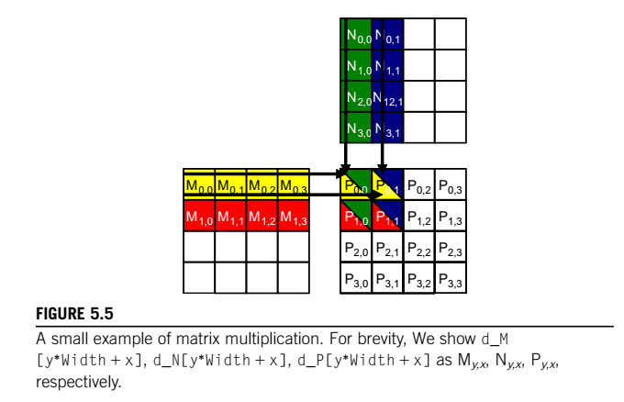
This example assumes that we use four 2 X 2 blocks to compute the P matrix

Slide 22
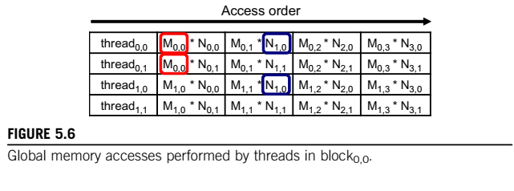

Slide 23
Note that each thread accesses four elements of M and four elements of N during its execution.
Among the four threads highlighted, there is a significant overlap in terms of the M and N elements they access.
For example, thread 0,0 and thread 0,1 both access M 0,0 as well as the rest of row 0 of M.
Similarly, thread 0,1 and thread 1,1 both access N 0,1 as well as the rest of column 1 of N.

Slide 24
The kernel is written so that both thread 0,0 and thread 0,1 access row 0 elements of M from the global memory.
If we can somehow manage to have thread 0,0 and thread 1,0 to collaborate so that these M elements are only loaded from global memory once, we can reduce the total number of accesses to the global memory by half
Therefore, if we can have all four threads to collaborate in their accesses to global memory, we can reduce the traffic to the global memory by half

Slide 25
Readers should verify that the potential reduction in global memory traffic in the matrix multiplication example is proportional to the dimension of the blocks used
With N X N blocks, the potential reduction of global memory traffic would be N.
That is, if we use 16 X 16 blocks, one can potentially reduce the global memory traffic to 1/16 through collaboration between threads

Slide 26
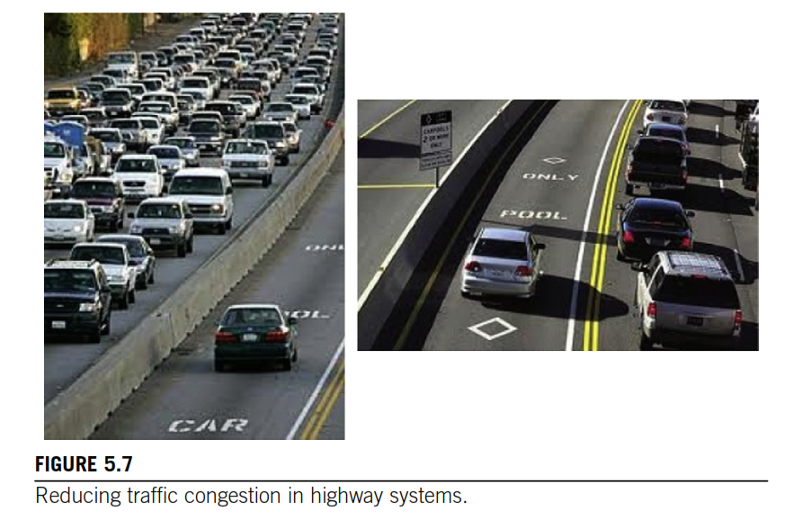

Slide 27
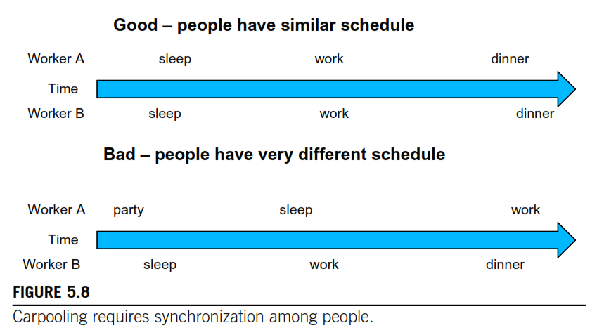

Slide 28
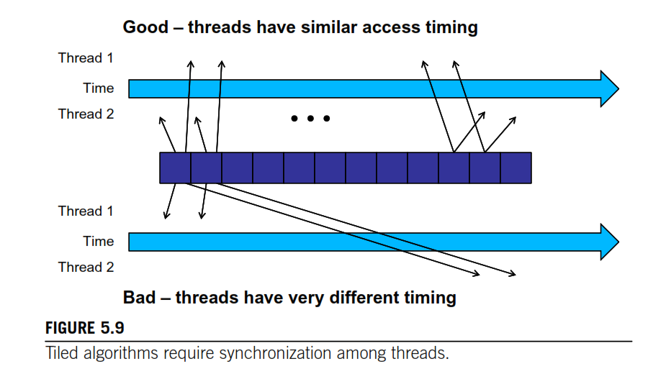

Slide 30
Tiled algorithms are very similar to carpooling arrangements.
We can think of data values accessed by each thread as commuters and DRAM requested as vehicles.
When the rate of DRAM requests exceeds the provisioned bandwidth of the DRAM system, traffic congestion arises and the arithmetic units become idle.
If multiple threads access data from the same DRAM location, they can form a “carpool” and combine their accesses into one DRAM request.

Slide 31
This, however, requires the threads to have a similar execution schedule so that their data accesses can be combined into one.
we will use barrier synchronization to keep the threads that form the “carpool” group to follow approximately the same execution timing.

